Slide 1
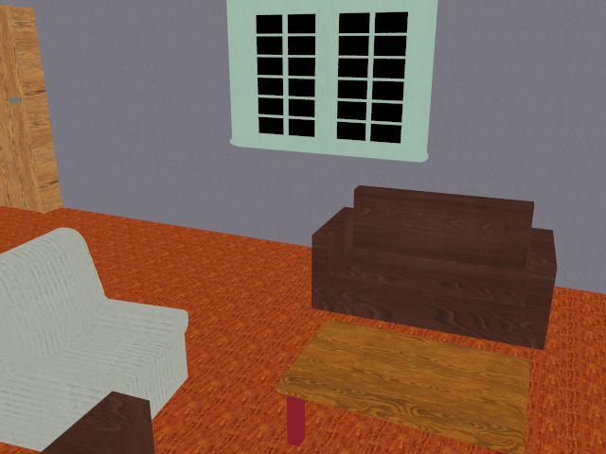
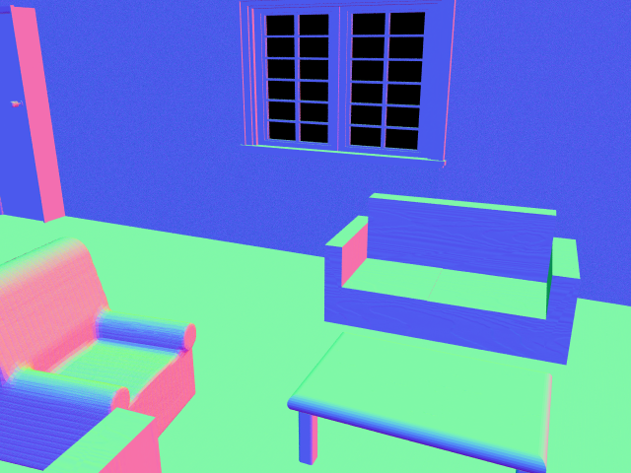
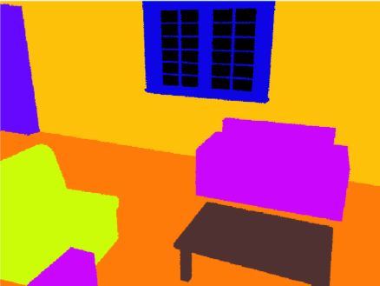
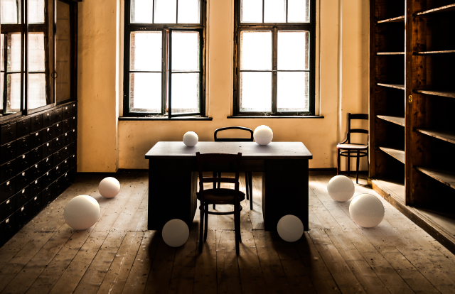
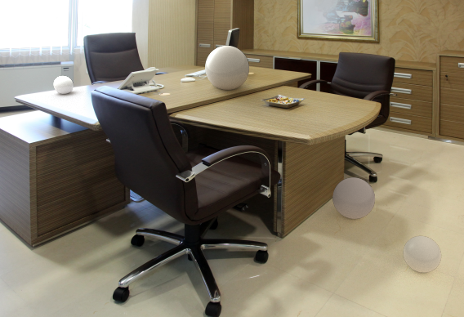
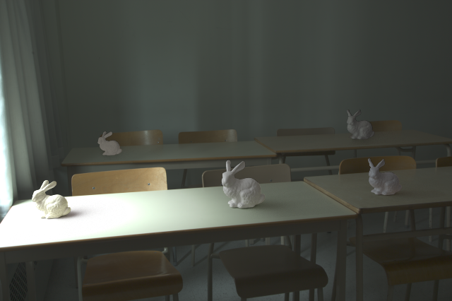
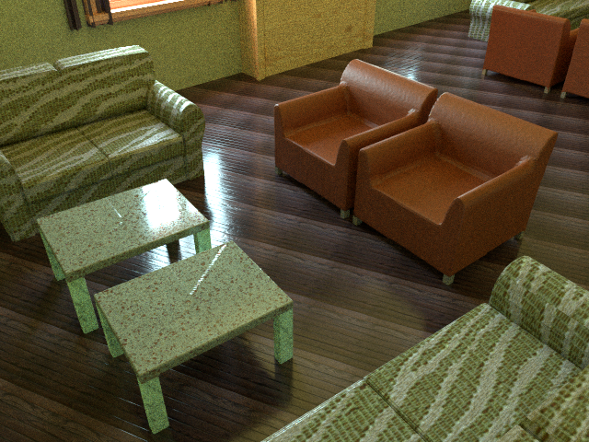
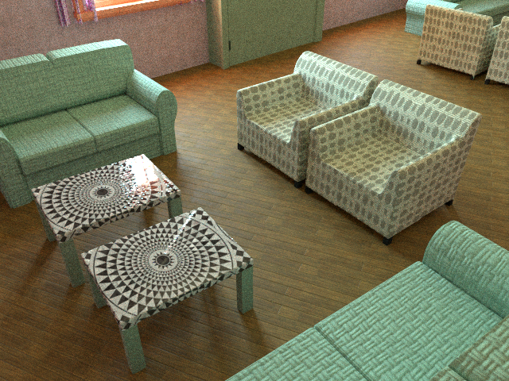
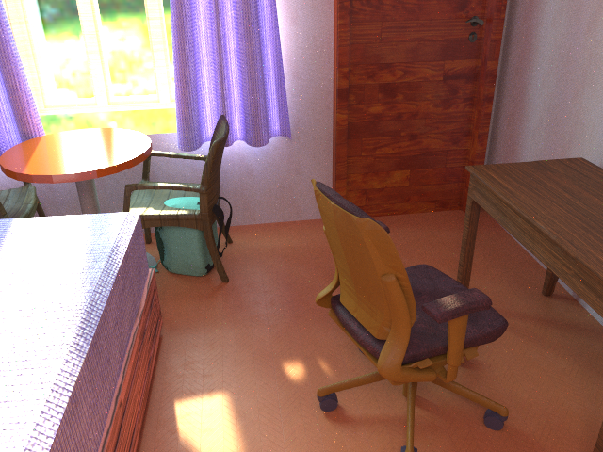
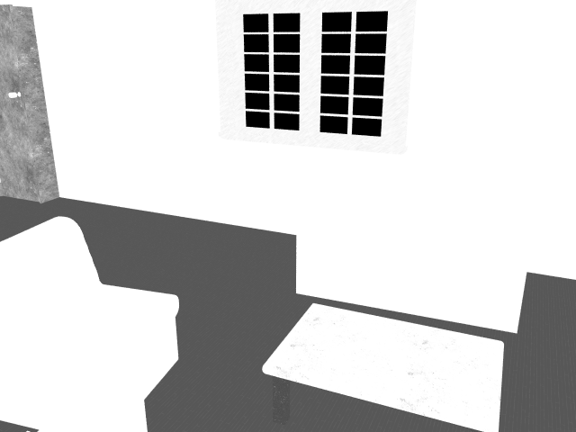
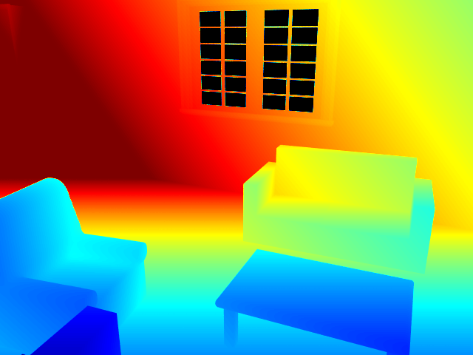
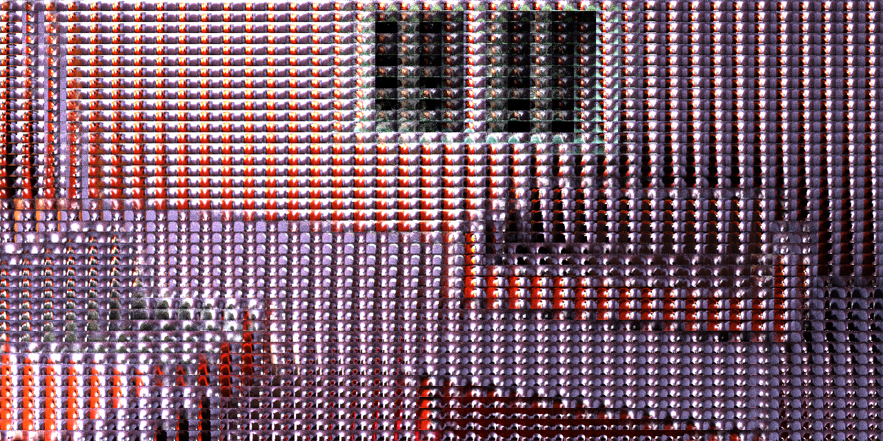
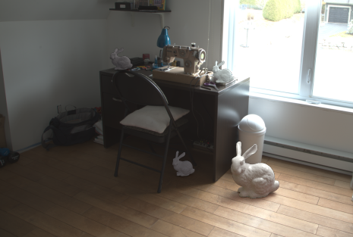
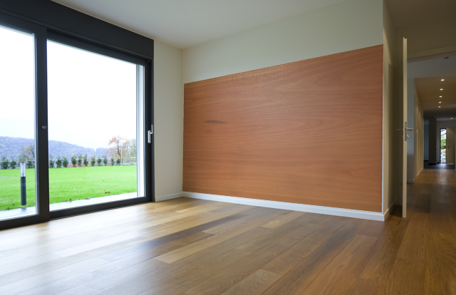
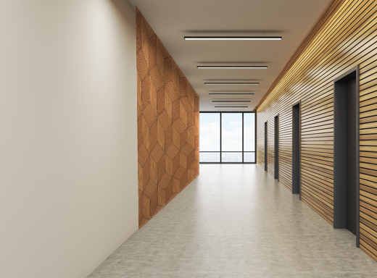
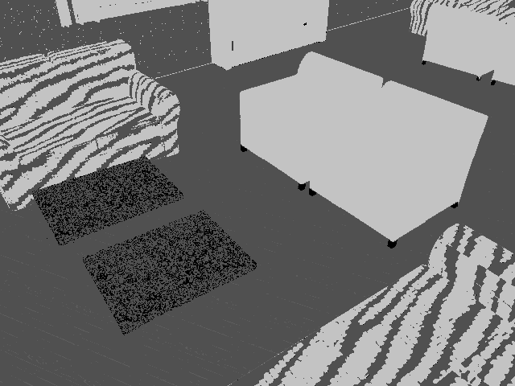
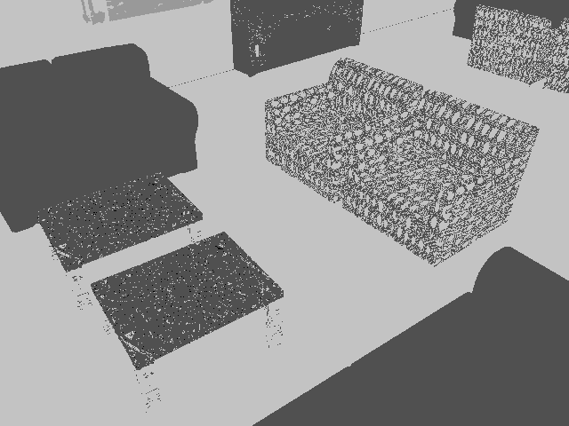
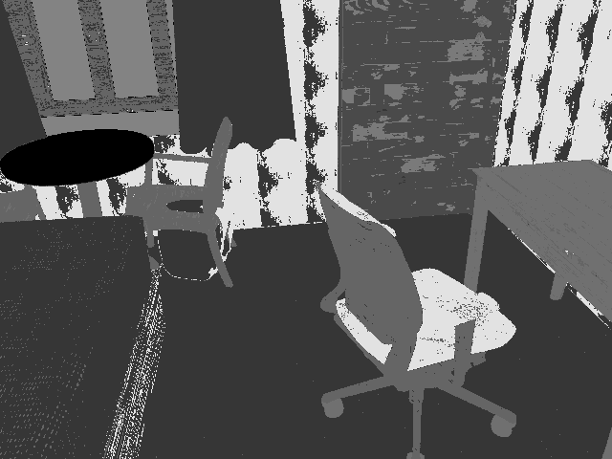
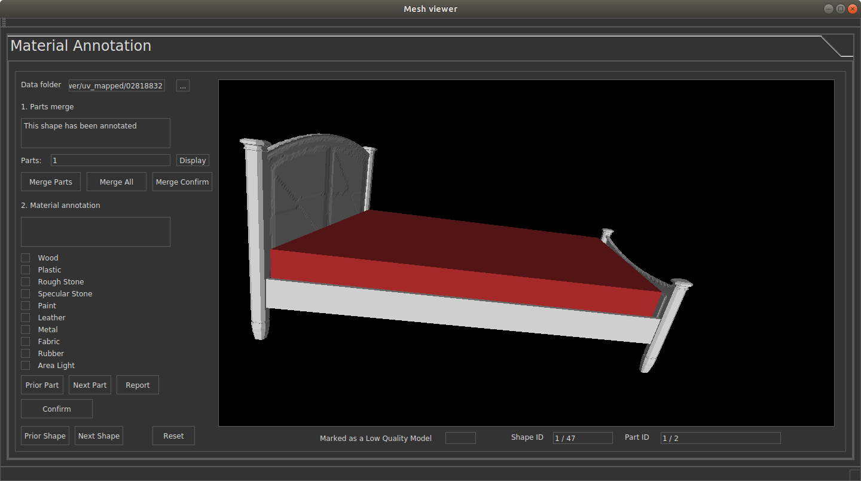
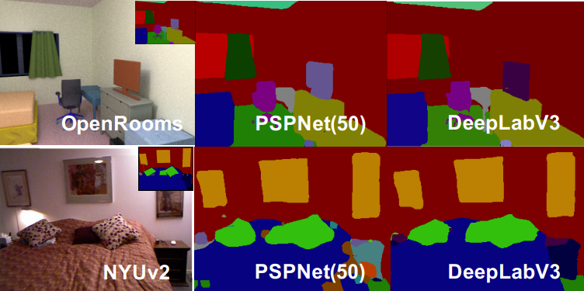
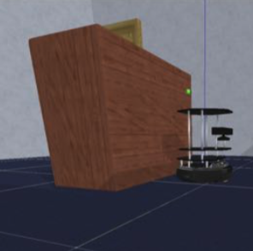
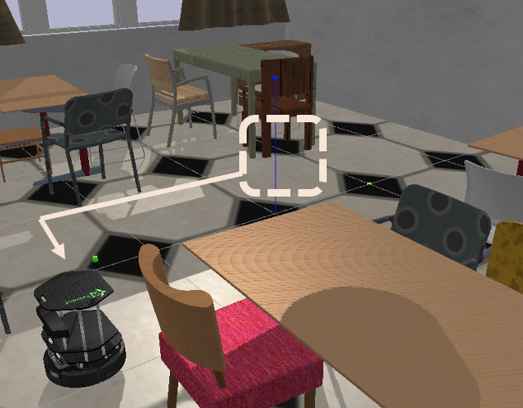
OpenRooms: An Open Framework
for Photorealistic Indoor Scenes
Zhengqin Li¹, Ting-Wei Yu¹, Shen Sang¹, Sarah Wang¹, Meng Song¹, Yuhan Liu¹, Yu-Ying Yeh¹, Rui Zhu¹, Nitesh Gundavarapu¹, Jia Shi¹, Sai Bi¹, Hong-Xing Yu¹, Zexiang Xu², Kalyan Sunkavalli², Miloš Hašan², Ravi Ramamoorthi¹, Manmohan Chandaraker¹
¹UC San Diego ²Adobe
Notes:
High-quality synthetic indoor datasets are of fundamental importance to various vision, graphics and robotics tasks. We propose OpenRooms, an open framework that can democratize the synthetic indoor dataset creation.

Slide 2
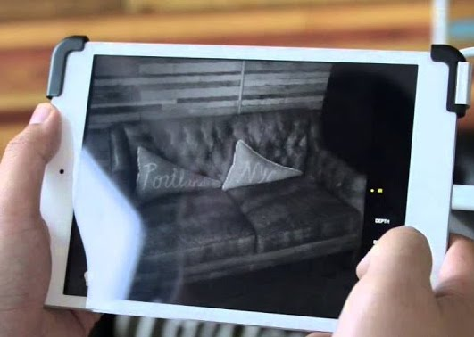
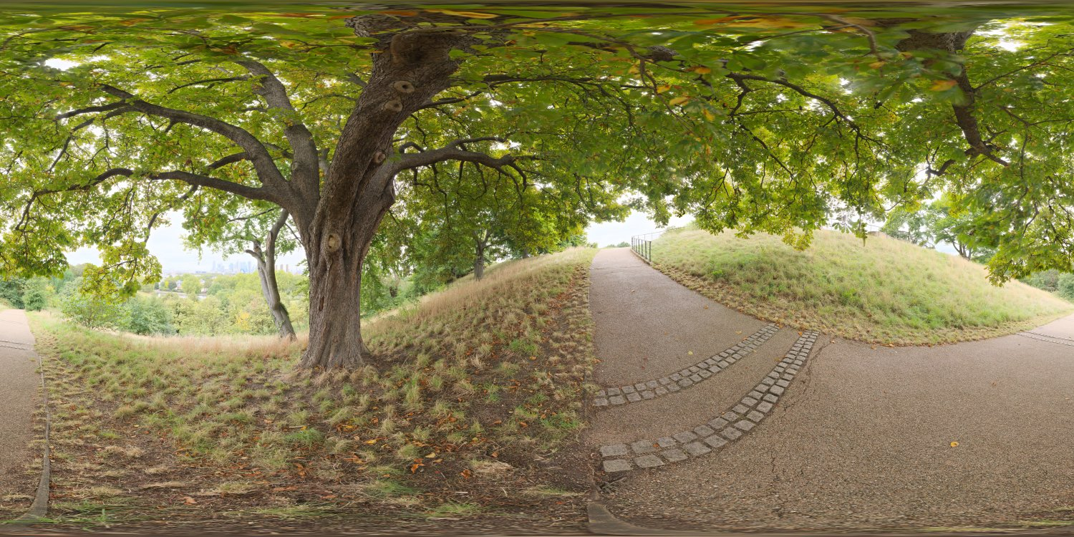
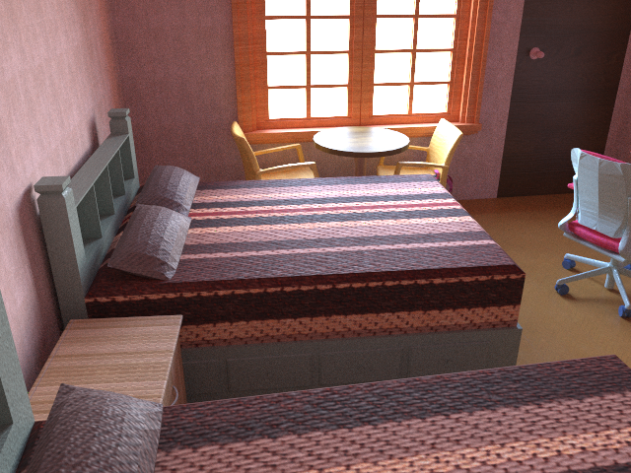
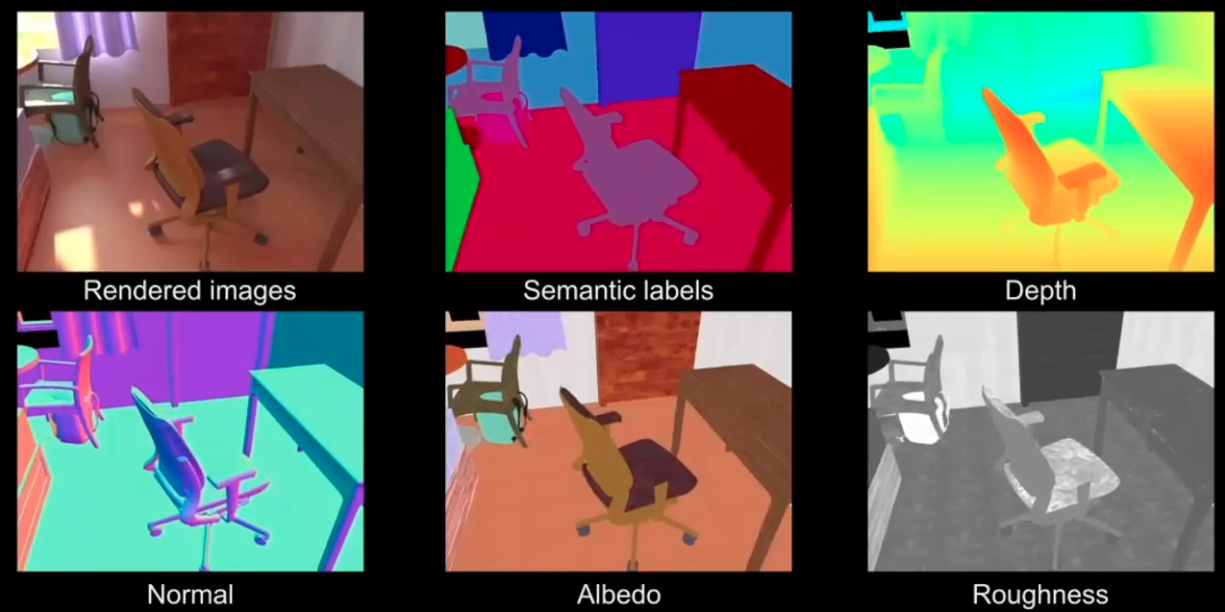
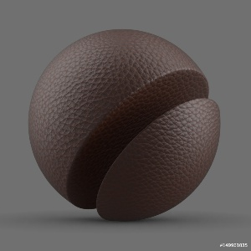
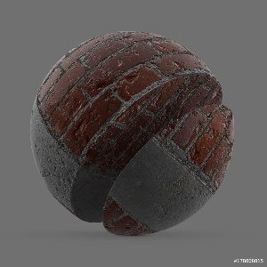
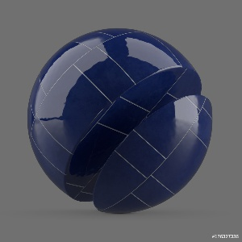
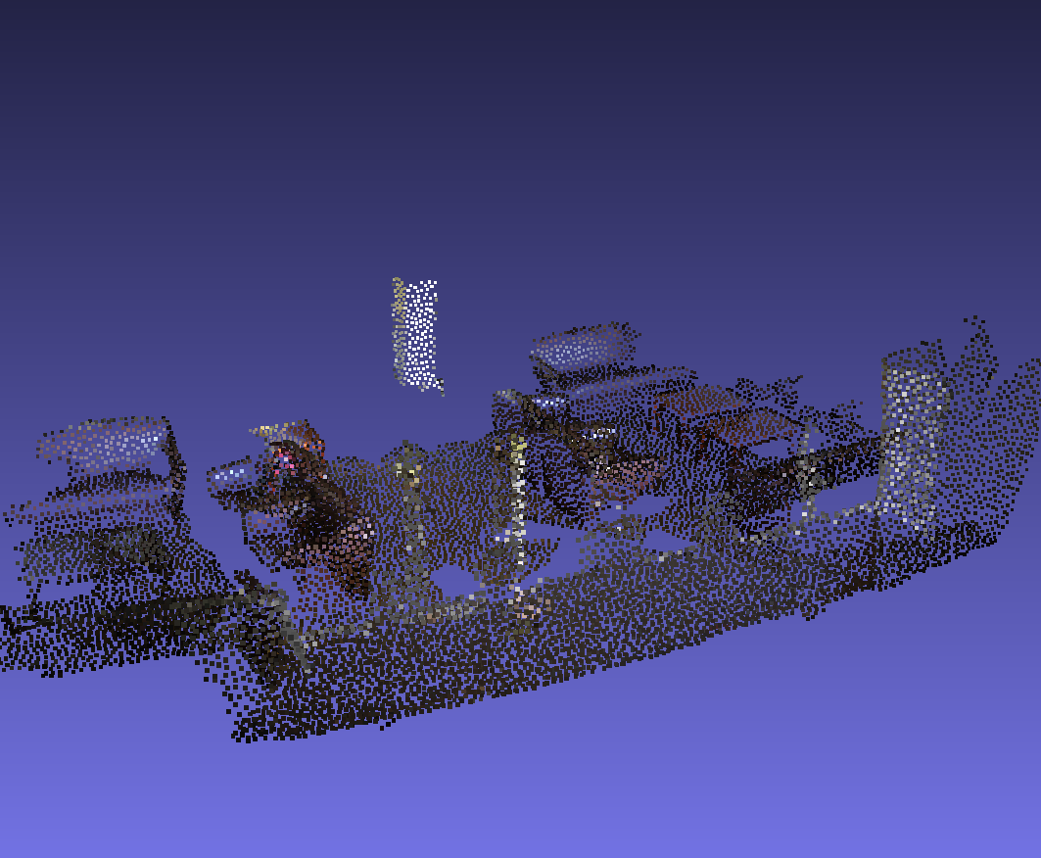
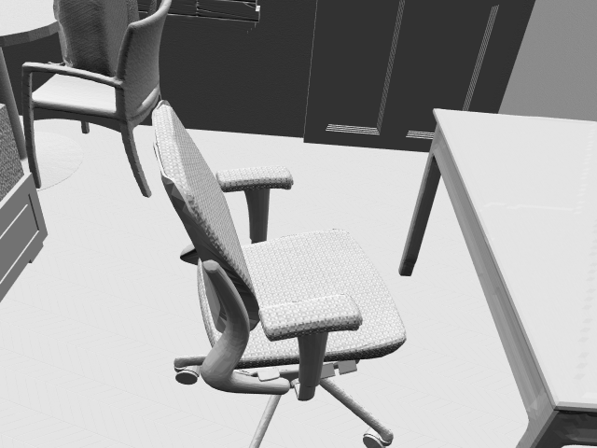
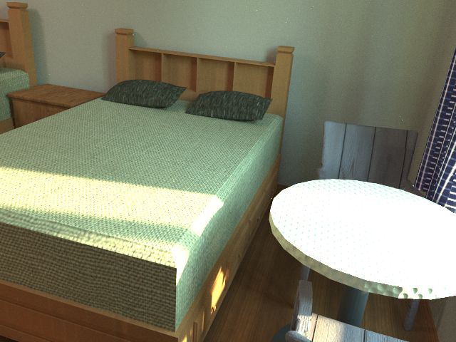
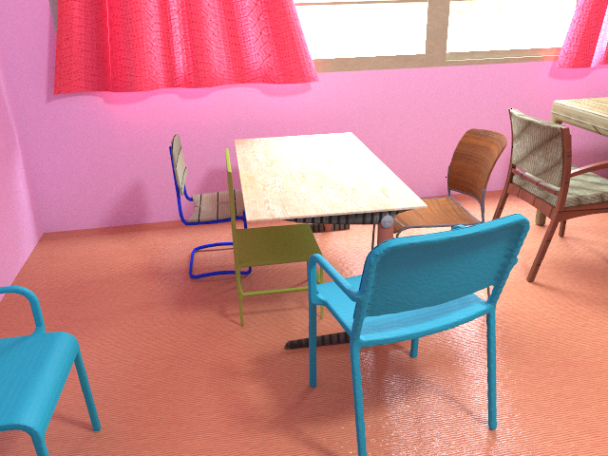
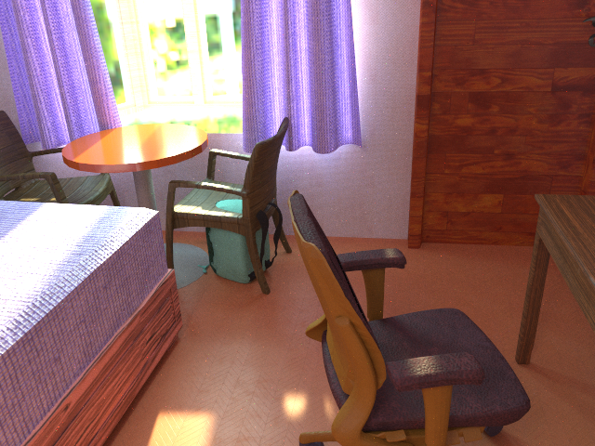
Overview of OpenRooms
Physically-based lighting
Commodity 3D sensor
Complex materials
Comprehensive ground-truths and formats
Scanned sparse point cloud
CAD models
Rendering your own images
Open tools for creating your own indoor datasets

Slide 3
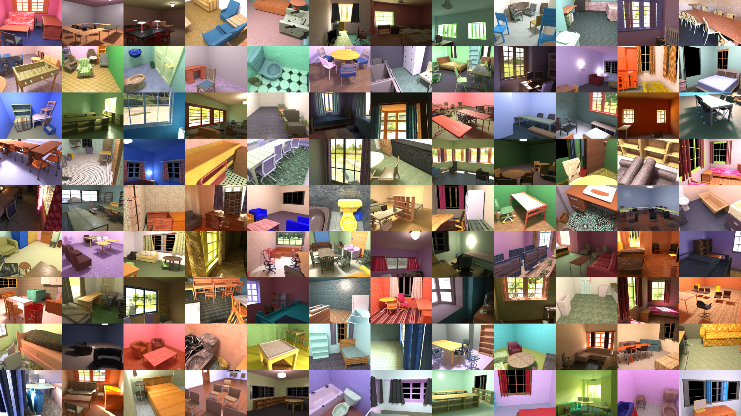
Notes:
With our framework, we create an instance of indoor dataset from the ScanNet real scans.

Slide 4
We render 118,233 HDR images for 1287 indoor scenes.
Notes:
We render about 120K images efficiently using our customized Optix path tracer.

Slide 5
Ground-truths and Formats
Images: The 480 × 640 HDR images im_*.hdr
Material: The 480 × 640 diffuse albedo maps imbaseColor_*.png and roughness map imroughness_*.png
Geometry: The 480 × 640 normal maps imnomral_*.png and depth maps imdepth_*.dat.
Mask: The 480 × 460 grey scale mask immask_*.png for light sources.
SVLighting: The (120 × 16) × (160 × 32) per-pixel envmaps imenv_*.hdr.
SVSG: The ground-truth spatially-varying spherical Gaussian (SG) parameters imsgEnv_*.h5
Shading: The 120 × 160 diffuse shading imshading_*.hdr
SVLightDirect: The (30 × 16) × (40 × 32) per-pixel envmaps with direct illumination imenvDirect_* .hdr
ShadingDirect: The 120 × 160 direct shading imshadingDirect_*.rgbe
SemanticLabel: The 480 × 640 semantic segmentation label imsemLabel_*.npy
LightSource:
  Geometry: The geometry annotation for windows and lamps box_*.dat
  Mask: The 120 × 160 2D binary masks for light sources mask*.png
  Direct shading: The 120 × 160 direct shading for each light source imDS*.rgbe
  Direct shading without occlusion:The 120 × 160 direct shading without occlusion imNoOcclu*.rgbe
  Shadow: The 120 × 160 shadow maps for each light source imShadow*.png
Friction: The friction coefficients computed from our SVBRDF

Slide 6
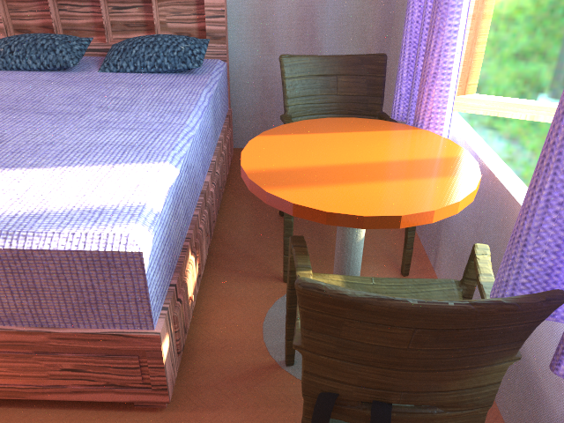
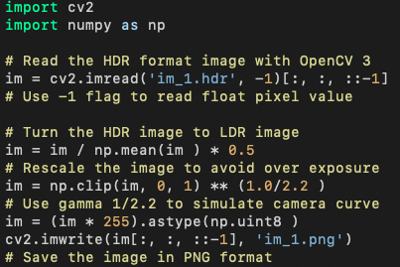
HDR Images
Name: im_*.hdr
Resolution: 480 x 640
To load the image and turn to LDR format, we may use the following python code
An example image

Slide 7
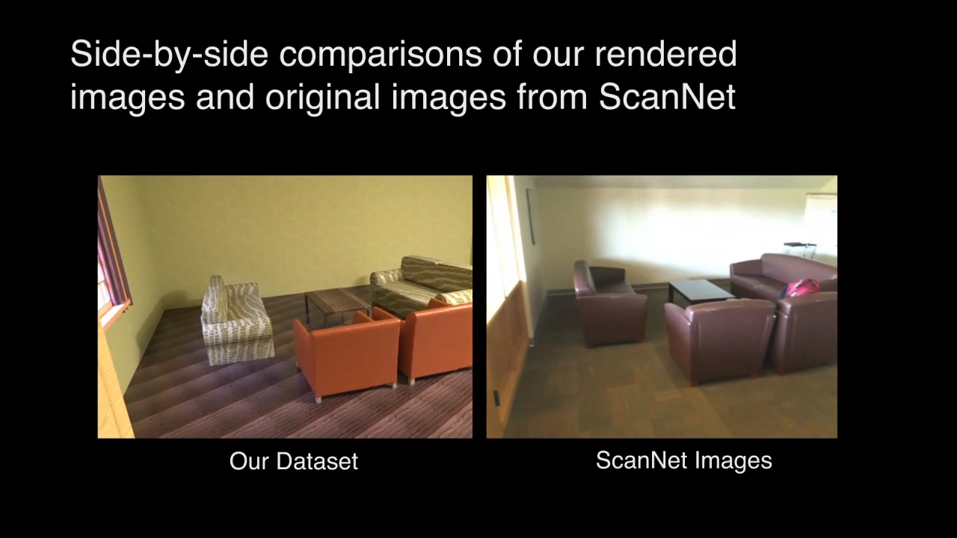
HDR Images: Comparisons with Real Images

Slide 8
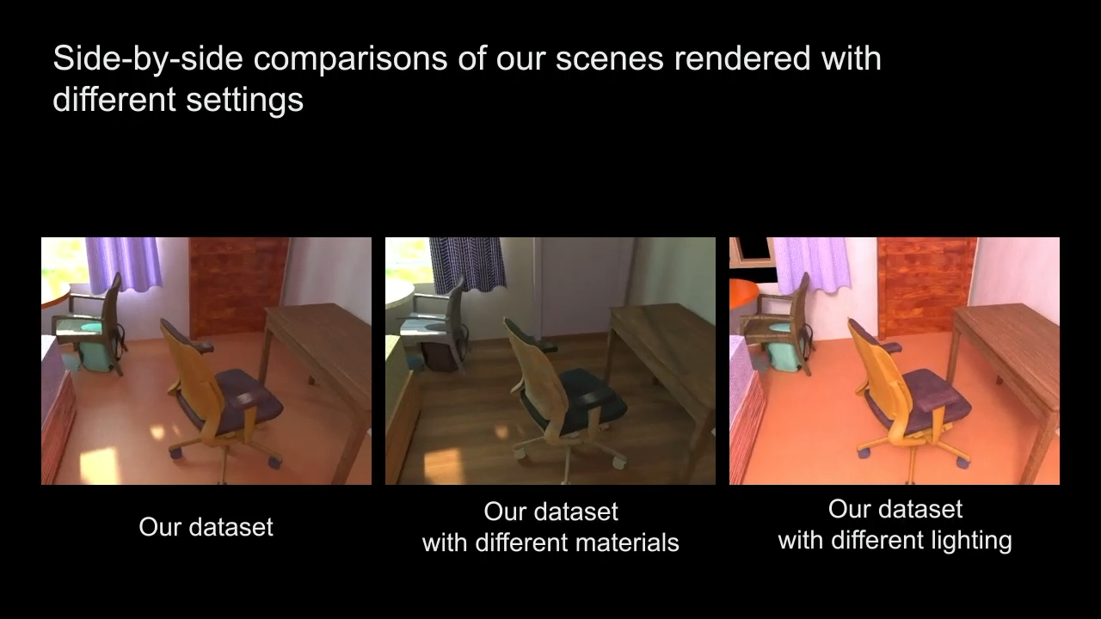
HDR Images: Different Configurations

Slide 9
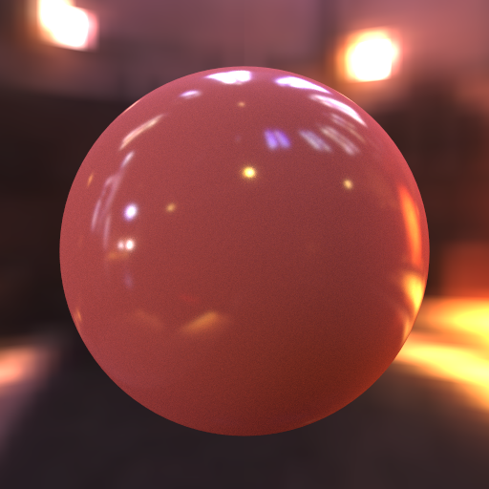
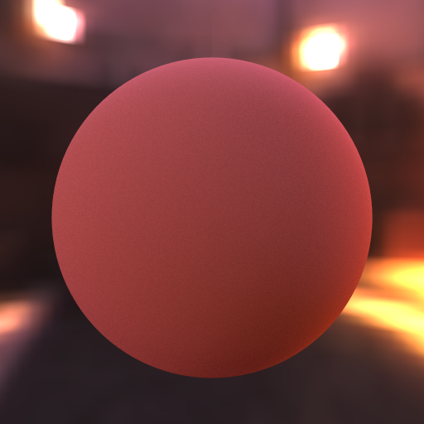
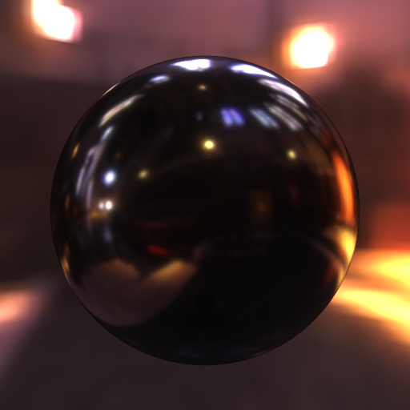

Materials: Diffuse Albedo and Roughness
Diffuse albedo
Roughness
$$f\left(ω_{o},ω_{i}\right)= \frac{ρ}{π}+\frac{D\left(ω_{o},ω_{i}, R\right)F\left(ω_{o},ω_{i}\right)G\left(ω_{o},ω_{i}, R\right)}{4\left(ω_{o}∙n\right)\left(ω_{i}∙n\right)}$$
Microfacet BRDF :
Detailed definition: link
Microfacet BRDF
Diffuse Reflectance
Specular Reflectance

Slide 10
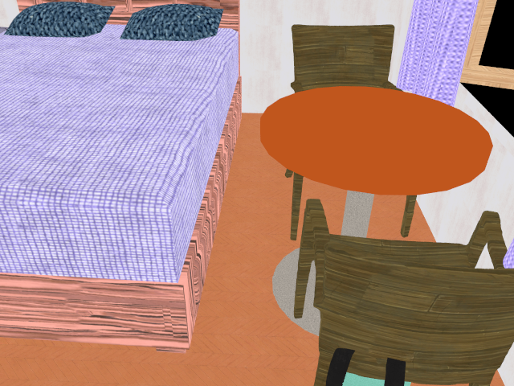
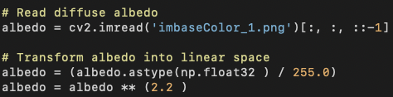
Materials: Diffuse Albedo
Name: imbaseColor_*.png
Resolution: 480 x 640
The image is in sRGB space. For rendering, we need to transform it to linear RGB space first.
Diffuse albedo

Slide 11
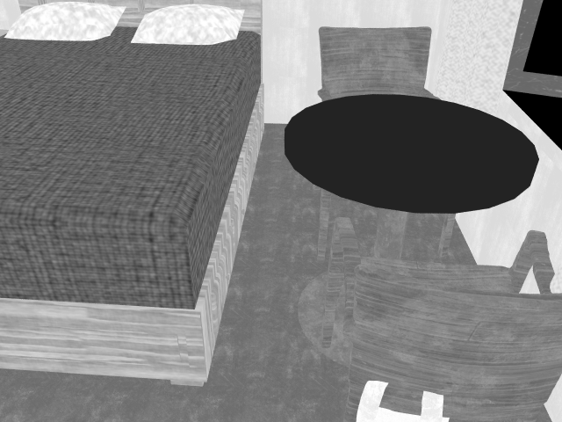
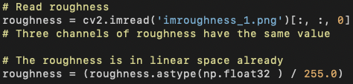
Materials: Roughness
Name: imroughness_*.png
Resolution: 480 x 640
The image is saved in linear space.
Roughness

Slide 12
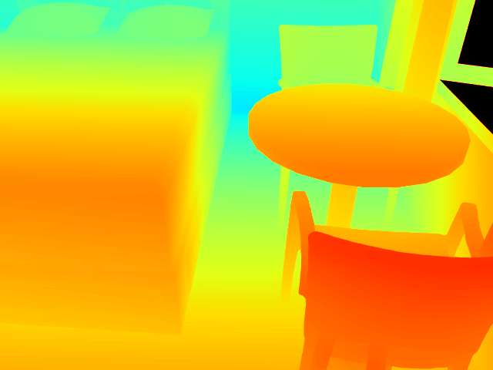
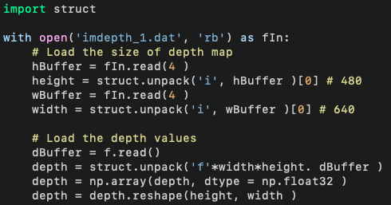
Geometry: Depth
Name: imdepth_*.dat
Resolution: 480 x 640
We use the following code to load depth maps
Depth

Slide 13
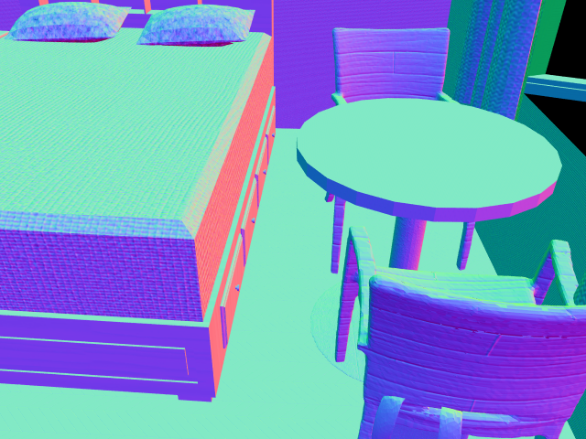
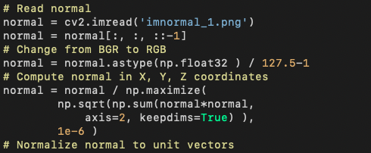
Geometry: Normal
Name: imnormal_*.png
Resolution: 480 x 640
The R,G,B color space corresponding to X, Y, Z axis respectively
We read the normal with the following code
Y
X
Camera
Z
📷
Image plane
Normal

Slide 14



Semantic Labels
Name: imsemLabel_*.npy
Resolution: 480 x 640
We provide 45 classes of commonly seen objects and layout for indoor scenes.
The distribution of the 45 classes:
Semantic label

Slide 15
Semantic Labels: Application
DeepLabV3 | mIoU (↑) | mAccu (↑)
OpenRooms | 42.9 | 55.1
InteriorNet | 42.2 | 54.4
PSPNet(50) | mIoU (↑) | mAccu (↑)
OpenRooms | 41.2 | 53.4
InteriorNet | 41.1 | 52.5
Notes:
The semantic segmentation networks trained on our dataset can also achieve similar performances on real data compared to those trained on a prior dataset created by artists.

Slide 16

Spatially-varying Lighting

Slide 17











Spatially-varying Lighting: Per-pixel Environment Maps
Name: imenv_*.hdr
Resolution: (120x16) x (160x32)
It contains 120x160 environment maps of a resolution 16x32 that describe the incoming radiance of a hemisphere
Input image
0
$$φ$$
$$2π$$
n
$$L_{i}\left(ω_{i}\right)$$
$$θ$$
$$θ$$
$$ω_{i}$$
$$φ$$
$$\frac{π}{2}$$
Per-pixel environment map

Slide 18


Spatially-varying Lighting: Applications
Code for object insertion: https://github.com/lzqsd/VirtualObjectInsertion.git

Slide 19



Spatially-varying Lighting: Applications
Method | OpenRooms | SUNCG | Garon 19
AMT approval rate | 38.89% | 34.84% | 29.15%
Ground-truth
OpenRooms
[Li et al. 20]
[Garon et al. 19]

Slide 20

Spatially-varying Lighting: Applications
Input image
Edited image

Slide 21







Spatially-varying Lighting: Per-pixel Spherical Gaussians
Environment map
(1536 params)
12 SG lobes, Ours
(72 params)
Name: imsgEnv_*.h5
Resolution: 120 x 160 x 12 x 6
Optimization: link
The code for data loading:
Spherical Gaussian
Per-pixel lighting

Slide 22


Spatially-varying Lighting: Shading
Name: imshading_*.hdr
Resolution: 120 x 160
Definition: The integral of per-pixel envmaps over the hemisphere.
Usage: Intrinsic decomposition, but cannot be used for specular materials and shadows
Code to turn per-pixel envmaps to shading
Input image
Shading

Slide 23

Spatially-varying Lighting: Per-pixel Direct Environment Maps
Name: imenvDirect_*.hdr
Resolution: (30x16) x (40x32)
It contains 30x40 environment maps of a resolution 16x32 that describe the incoming radiance of a hemisphere but without interreflection.
Input image
Per-pixel direct environment maps

Slide 24

Spatially-varying Lighting: Direct Shading
Name: imshadingDirect_*.hdr
Resolution: 120 x 160
Definition: Similar to shading but with direct illumination only
Input image
Per-pixel direct environment maps

Slide 25

Light Sources

Slide 26

Light Sources: Geometry
Name: light*/box_*.dat
Contents:
  isWindow: True if the light source is a window, False if it is a lamp
  box3D: The 3D bounding box of the light source in the camera coordinate system, including location (center), orientations (xAxis, yAxis, zAxis) and size (xLen, yLen, zLen)
  box2D: The 2D bounding box of the light source on the image (x1, y1, x2, y2)
The python code to read the dictionary
Window
Light source geometry

Slide 27



Light Sources: Direct Shading
Name: light_*/imDS*.rgbe
Resolution: 120 x 160
Definition: the direct shading of each individual light source
The code to load shading is the same as other HDR images.
Input image
Direct shading of the invisible lamp
Direct shading of the visible window
Direct shading of the invisible window

Slide 28



Light Sources: Direct Shading without Occlusion
Name: light_*/imDSNoOcclu*.rgbe
Resolution: 120 x 160
Definition: the direct shading of each individual light source without occlusions
The code to load shading is the same as other HDR images.
Input image
Direct shading of the invisible lamp
Direct shading of the visible window
Direct shading of the invisible window

Slide 29



Light Sources: Applications
Real input image
Rendered virtual lamps at different locations

Slide 30






Physical Properties: Friction Coefficients
Images with different materials
Roughness
Friction coefficient

Slide 31

Physical Properties: Applications
High friction coefficient
Low friction coefficient

Slide 32
Overview of OpenRooms
Physically-based lighting
Commodity 3D sensor
Complex materials
Comprehensive ground-truths and formats
Scanned sparse point cloud
CAD models
Rendering your own images
Open tools for creating your own indoor datasets

Slide 33







Rendering OpenRooms: Summary
Materials
Lighting
Geometry
Scene configuration and camera poses
Efficient customized renderer

Slide 34
Directory Structure for Rendering OpenRooms
OpenRoomsDataset:
BRDFOriginDataset # SVBRDFs
  Material__gold_leaf_fold_fold_sharp … # Texture maps for each SVBRDF
EnvDataset # HDR outdoor envmaps for lighting
layoutMesh # Mesh for layout
  scene0000_01 …
uv_mapped # Mesh for furniture
  window … # Categories of furniture
    1 … # Obj file for each furniture
data
  rendering
    data # Rendered inputs and ground-truths
      main_xml, mainDiffMat_xml, mainDiffLight_xml # Different configurations
        scene0000_01 …
      main_xml1, mainDiffMat_xml1, mainDiffLight_xml1
    scenes # Scene config and camera poses
      xml
        scene0000_01 …
      xml1
        scene0000_01 …

Slide 35
Rendering OpenRooms: SVBRDFs
Location: BRDFOriginDataset
Dataset: Adobe Stock Dataset
Size: 1329 SVBRDF texture maps
Price: Around 500 dollars

Slide 36



Rendering OpenRooms: SVBRDFs
Location: BRDFOriginDataset
Dataset: Adobe Stock Dataset
Size: 1329 SVBRDF texture maps
Price: Around 500 dollars
Albedo
Normal
Roughness

Slide 37






Rendering OpenRooms: Free SVBRDFs
Adobe stock
Free Substance share
Image
Different lighting
Different material

Slide 38


Rendering OpenRooms: Lighting
Indoor lamp intensity sampled from black body model
A synthetic image
Outdoor lighting from captured outdoor environment maps

Slide 39
Rendering OpenRooms: Outdoor Lighting
Location: EnvDataset
Dataset1: HDRI Haven
Size: 209 HDR panoramas
These environment maps can be shared and redistributed
Dataset2: Laval dataset
Size: 205 HDR panoramas
These environment maps cannot be shared and redistributed. Please contact authors
Note that the exposure of the two datasets are different. We provide code transformEnvmap.py to align them together
The Laval Ourdoor HDR Dataset
HDRI Haven Dataset

Slide 40


Rendering OpenRooms: Geometry
Layout meshes
Location: layoutMesh
Num: 1287 layouts for 1287 indoor scenes
Furniture meshes
Location: uv_mapped
Num: 40 types of furniture, 3067 CAD models from the PartNet dataset
Layout mesh
Furniture mesh

Slide 41

Rendering OpenRooms: Camera Poses
Location: /data/rendering/scenes/xml(1)/scene*_*/cam.txt
Format:
  N # Number of camera views
  x x x # Original point for the camera
  y y y # Target point for the camera
  z z z # Up vector for the camera
  …
Up vector
Target point
Original point
📷
Image plane

Slide 42
Rendering OpenRooms: Scene Configuration
Location:
  /data/rendering/scenes/xml(1)/scene*_*/main(DiffMat, DiffLight).xml
Instructions: Link
Relationships:
  xml/main.xml and xml/mainDiffMat.xml have the same lighting but different materials.
  xml/main.xml and xml/mainDiffLight.xml have the same material but different lighting.
  xml/main.xml and xml1/main.xml have different lighting and materials
Correspondence to rendered results
  xml/main.xml → main_xml
  xml1/main.xml → main_xml1
  xml/mainDiffMat.xml → mainDiffMat_xml
  xml1/mainDiffMat.xml → mainDiffMat_xml1
  xml/mainDiffLight.xml → mainDiffLight_xml
  xml1/mainDiffLight.xml → mainDiffLight_xml1

Slide 43












Rendering OpenRooms: Optix-based GPU Renderer
Location: Link
Typical rendering time on 2080Ti:
  480 x 640 image: 600s
  Per-pixel envmap: 100s
Takes around 1 month to render the whole dataset with 40 GPUs
Mitsuba, path, 900 samples,
time 164.5s, PSNR 24.88
Mitsuba, bdpt, 625 samples,
time 165.0, PSNR 26.01
Our renderer, path, 16354 samples,
time 162.44s, PSNR 37.06
Reference, path, 65546 samples

Slide 44
Rendering OpenRooms: Optix-based GPU Renderer
Location: Link
Typical rendering time on 2080Ti:
  480 x 640 image: 600s
  Per-pixel envmap: 100s
Takes around 1 month to render the whole dataset with 40 GPUs

Slide 45

Rendering OpenRooms: Optix-based GPU Renderer
Code: renderImg.py
Useful flags:
  --xmlRoot: the folder of xml or xml1
  --rs: starting scene id
  --re: end scene id
  --outRoot: where to save the rendered results
  --program: the binary file of the renderer
  --forceOutput: overwrite prior results
  --mode:
    0: Render images
    1: Render diffuse albedo
    2: Render normal
    3: Render Roughness
    4: Render light source mask
    5: Render depth
    6: Render metallic
    7: Render per-pixel lighting …
We will show a demo

Slide 46
Overview of OpenRooms
Physically-based lighting
Commodity 3D sensor
Complex materials
Comprehensive ground-truths and formats
Scanned sparse point cloud
CAD models
Rendering your own images
Open tools for creating your own indoor datasets

Slide 47







Open Tools: SVBRDF Annotation
Fabric
Leather
Metal
Paint
Plastic
Rubber
Rough Stone
Specular Stone
Wood
A UI to efficiently assign 10 material class labels to each object part.

Slide 48
Open Tools: Lighting Annotation
Indoor lamp intensity sampled from black body model
A synthetic image
Outdoor lighting from captured outdoor environment maps

Slide 49

Open Tools: Layout Annotation
A UI to efficiently annotate room layout from sparsely scanned point cloud.

Slide 50

Open Tools: Detection of Windows and Doors
A tool to detect windows and doors

Slide 51

Open Tools: Consistent Furniture and Layout
A tool to adjust the furniture position to make it consistent with the scene layout

Slide 52

Please visit our project webpage for all code, data and applications:
https://vilab-ucsd.github.io/ucsd-openrooms/
Notes:
Please visit our project page for all code, data and the applications.

